Slide 1

Policy Advisory Committee
Fiscal Sustainability: 12/08/2025

Slide 2
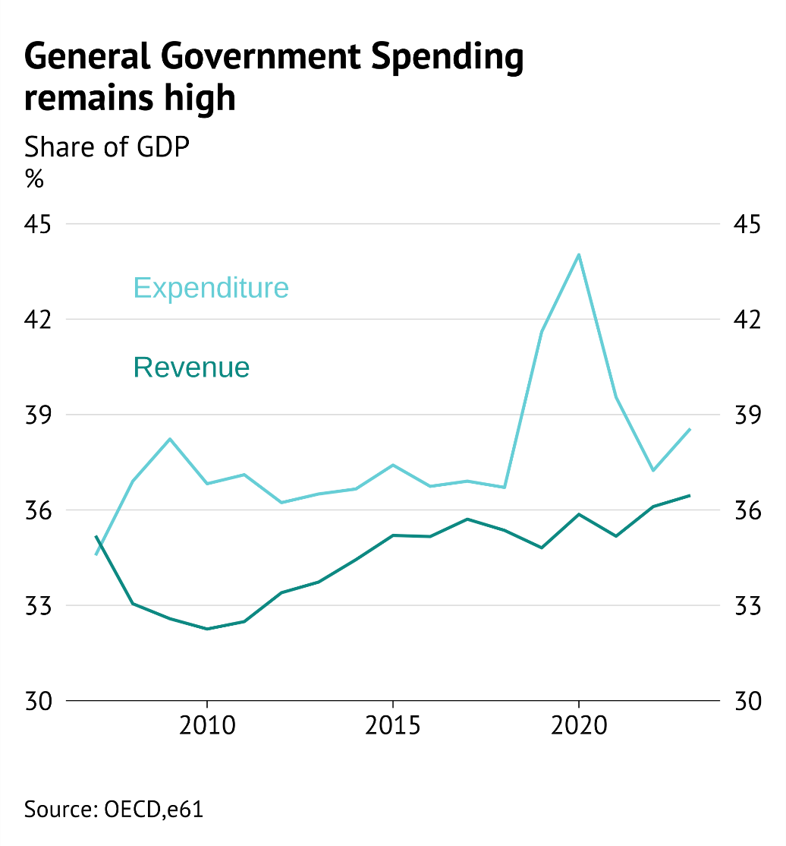
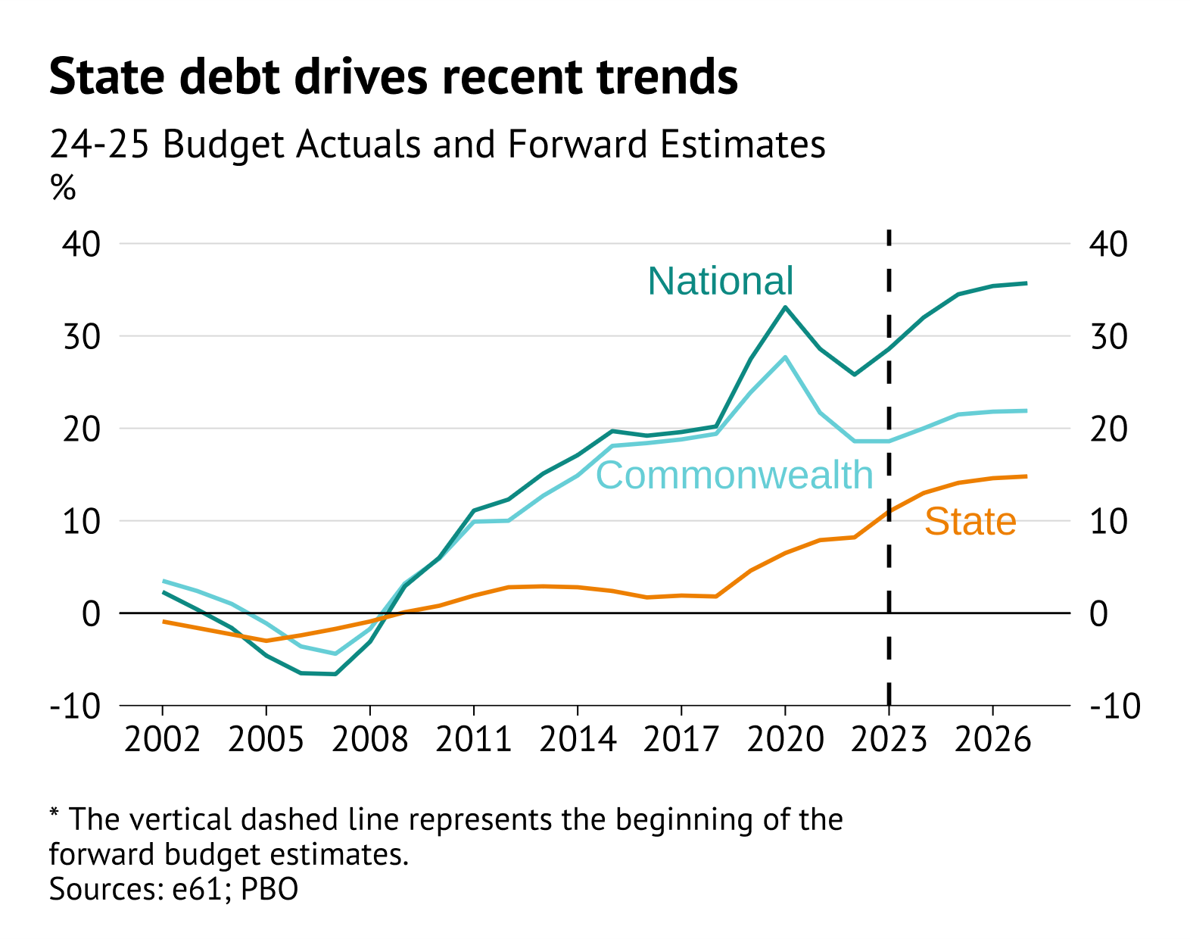

What is fiscal sustainability
Fiscal Sustainability
Debt spiral
OECD
Resilience
Equity (both intra and intergenerational)

Slide 3
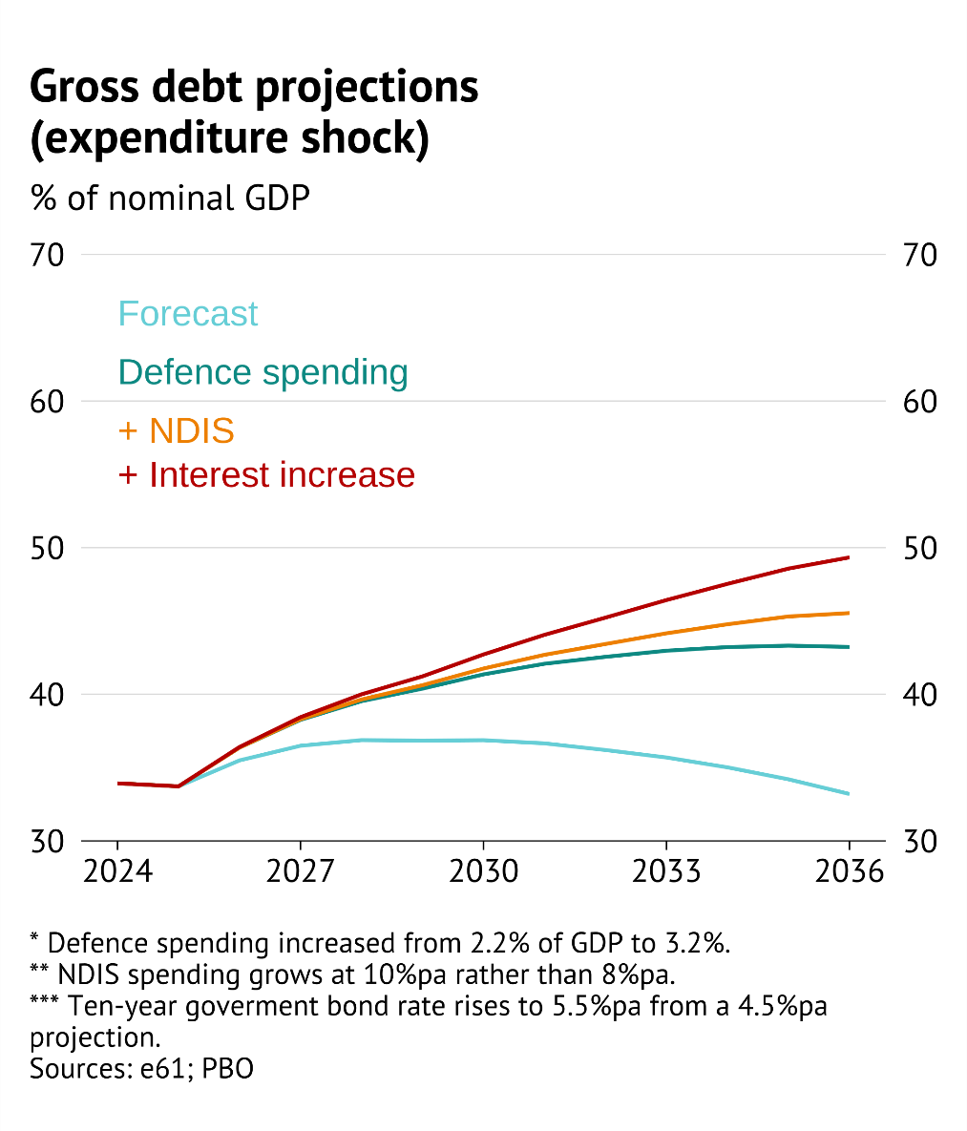
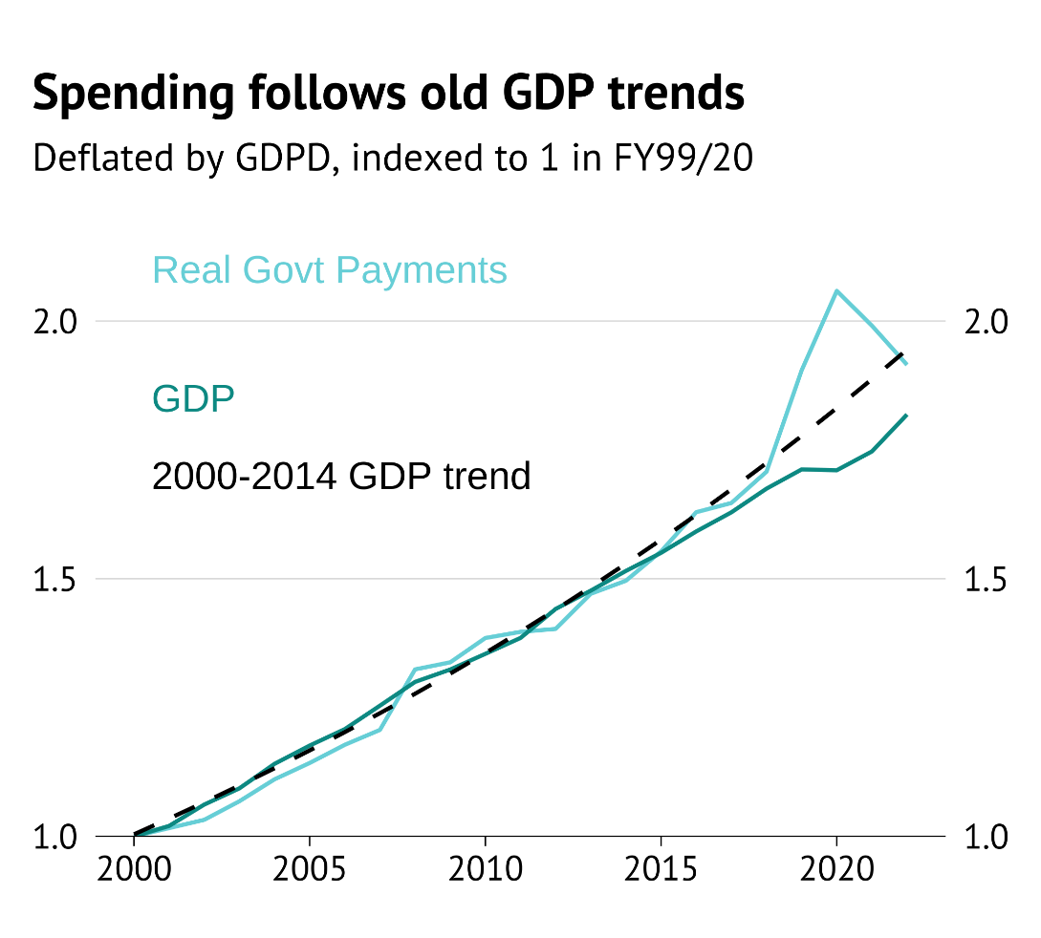
Fiscal position, shocks, and stickiness
Fiscal Sustainability
Revenue and total

Slide 4
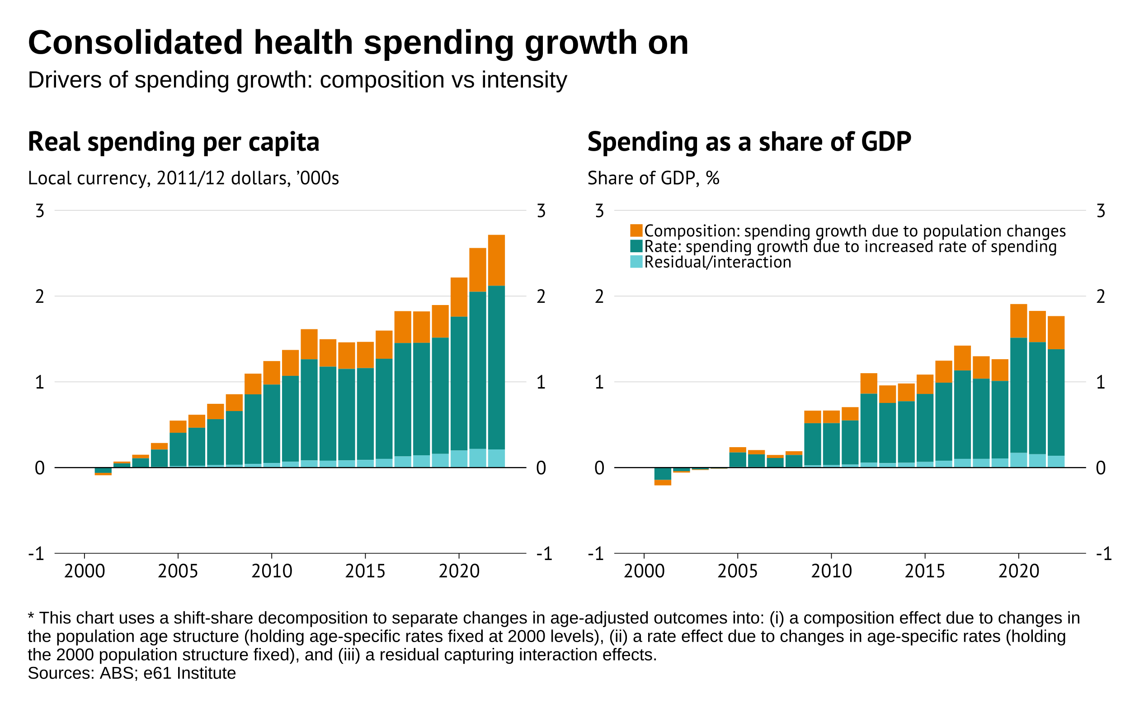
Insights from consolidation
Fiscal Sustainability
Health spending partially driven by ageing – but largely greater spending.
Education spending should be more restrained based on ageing alone.
Nature of transfer system shifting from income support for families and those with disabilities to in-kind support.
Link
Health
Education
Transfers

Slide 5
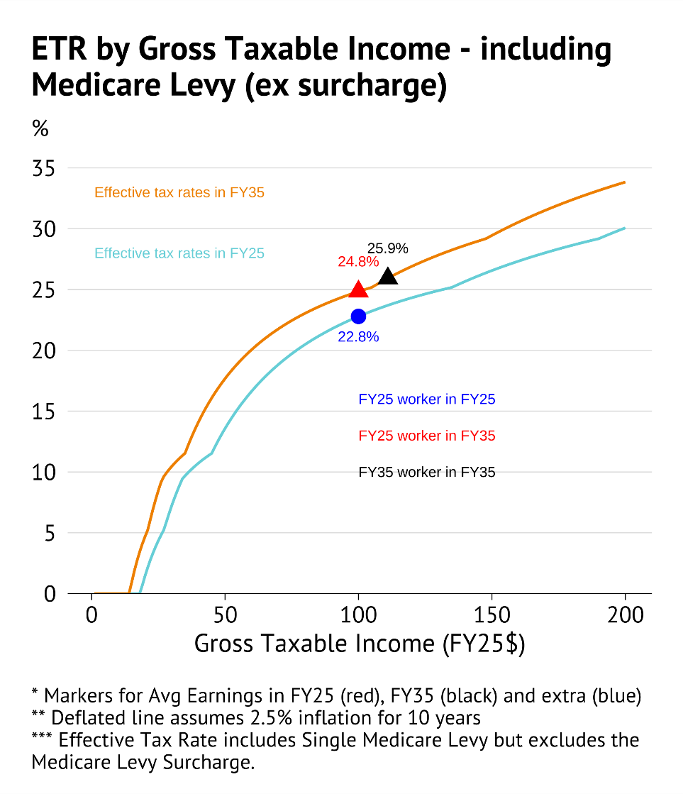
Burden of payment
Fiscal Sustainability
Universalism and greater services require a larger government.
Current projections assume this is tacitly funded by fiscal drag.
Combination of:
Increased borrowing.
Lower productivity and wage growth.
Higher future income tax liabilities.
Favourable tax treatment of capital gains and superannuation.
More universal current service provision.
Is an intergenerational transfer from future generations to current generations.
TTPI estimates

Slide 6
Background plots

Slide 7
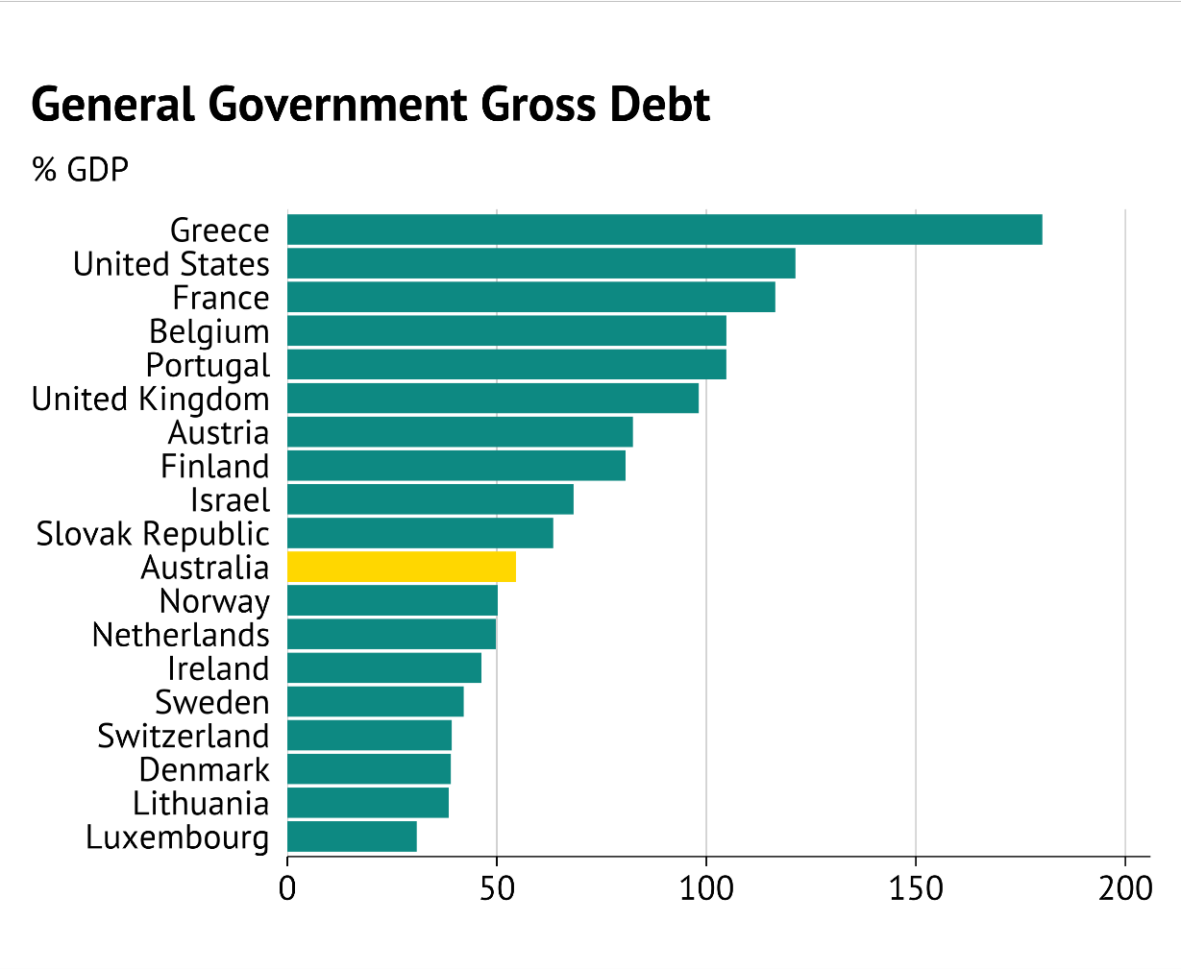
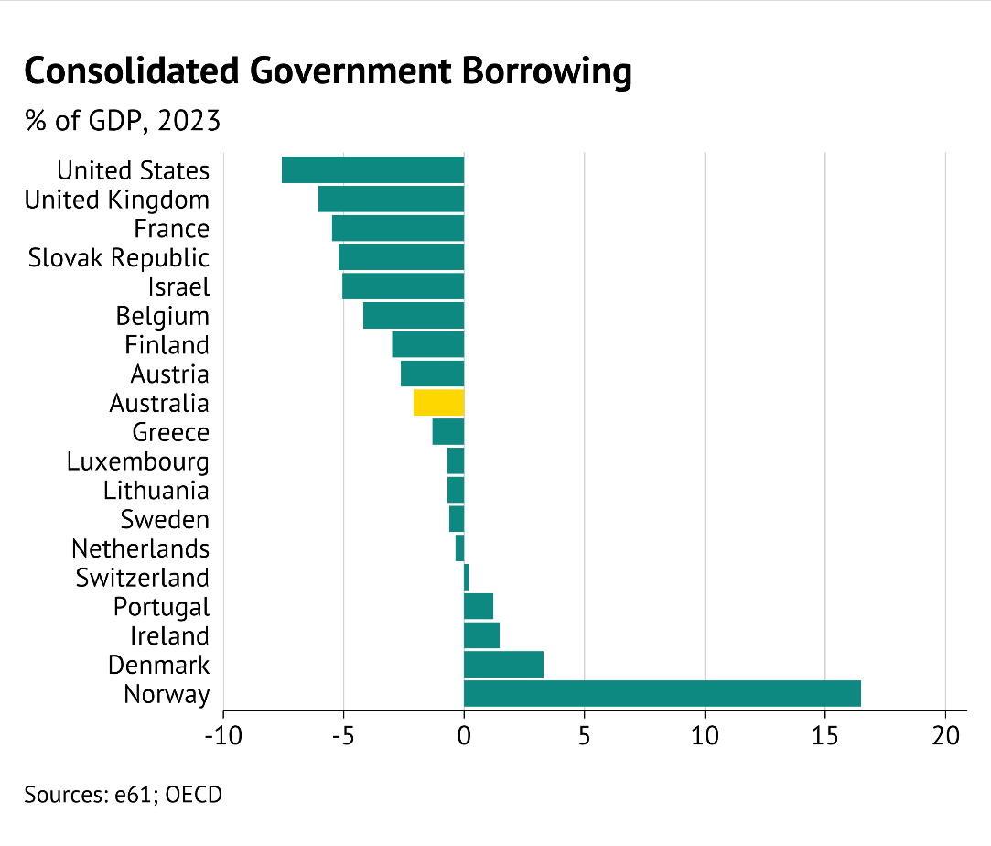
Consolidation of debt (OECD)
Back

Slide 8
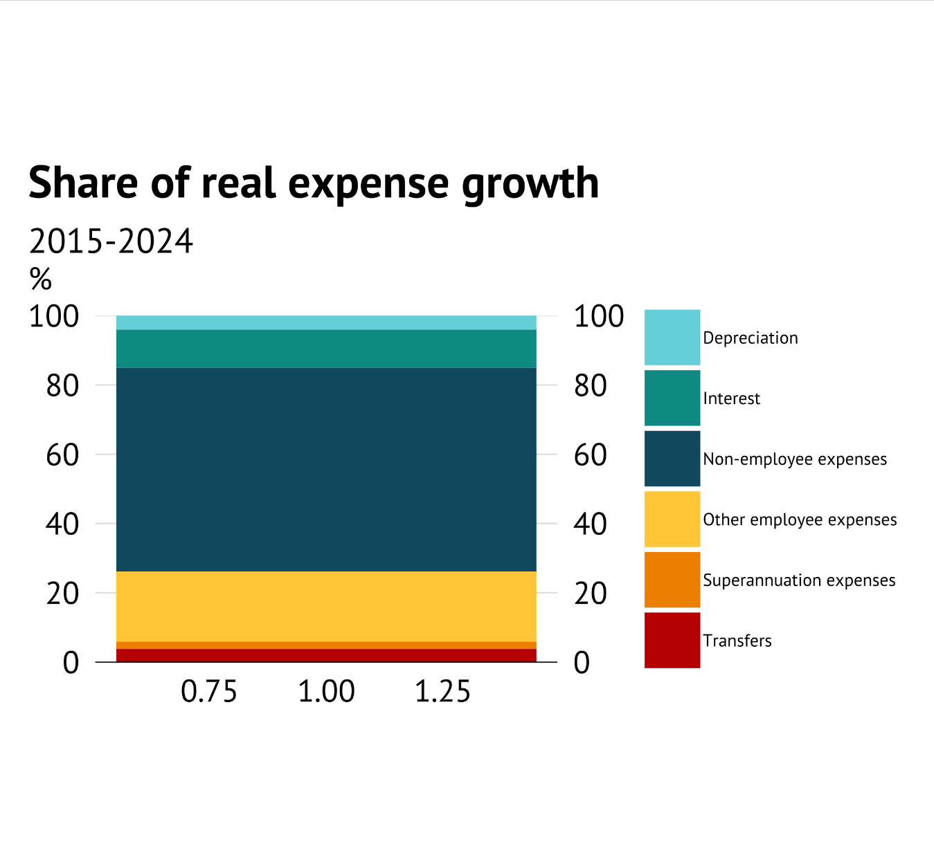
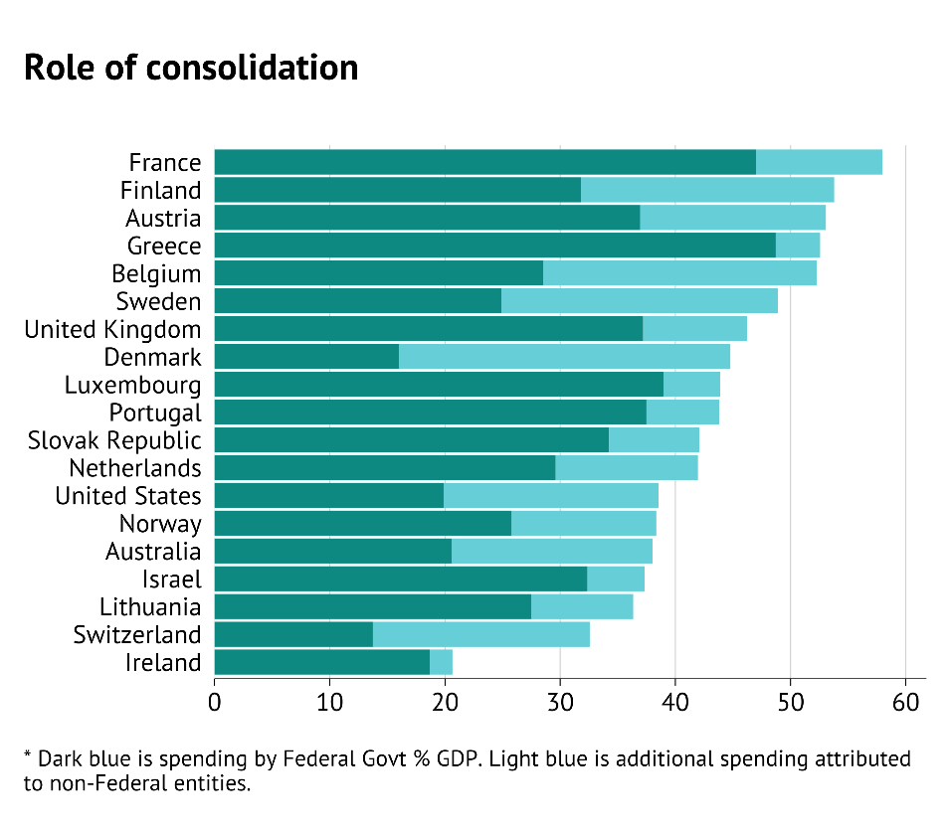
Consolidation of spending (OECD)

Slide 9
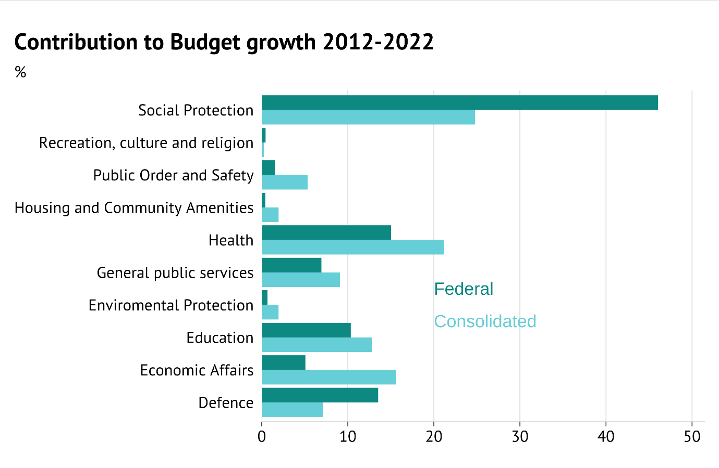
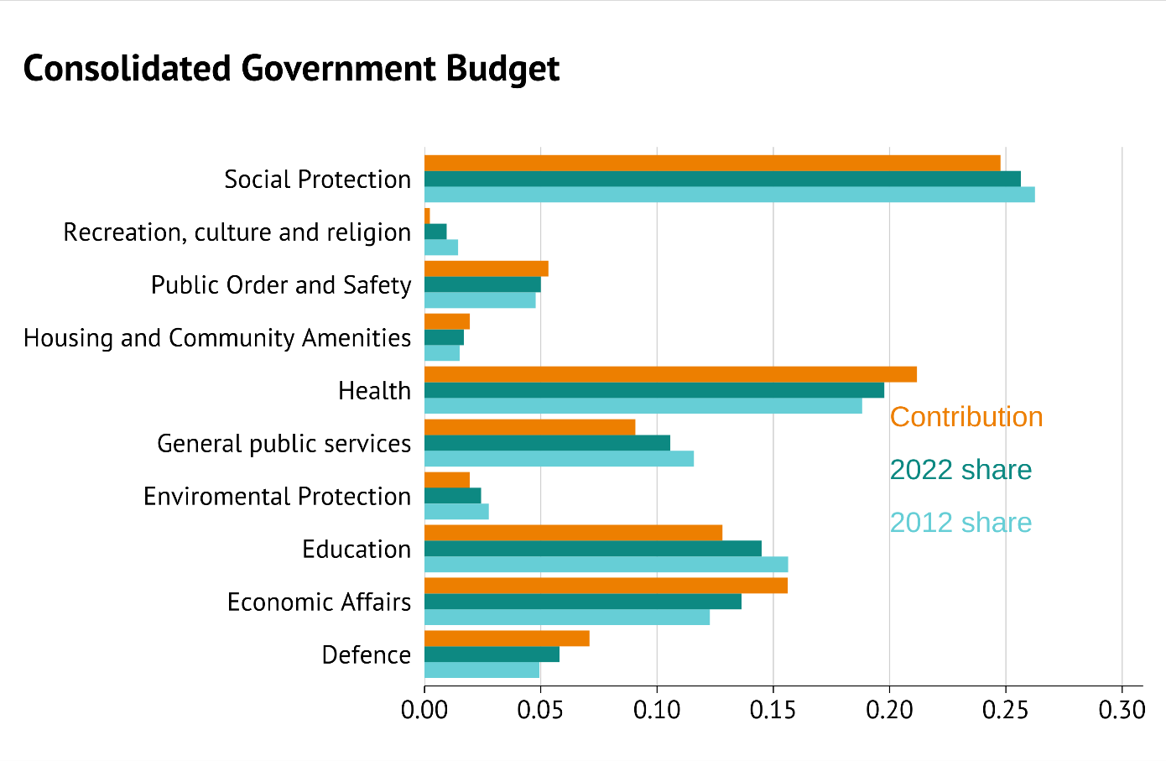
Function drivers

Slide 10
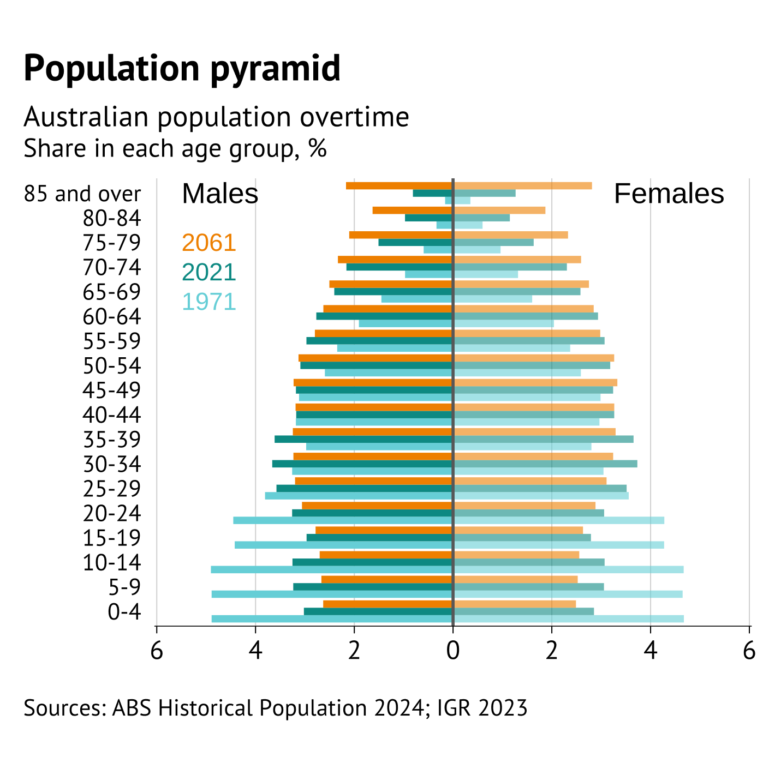
Ageing

Slide 11
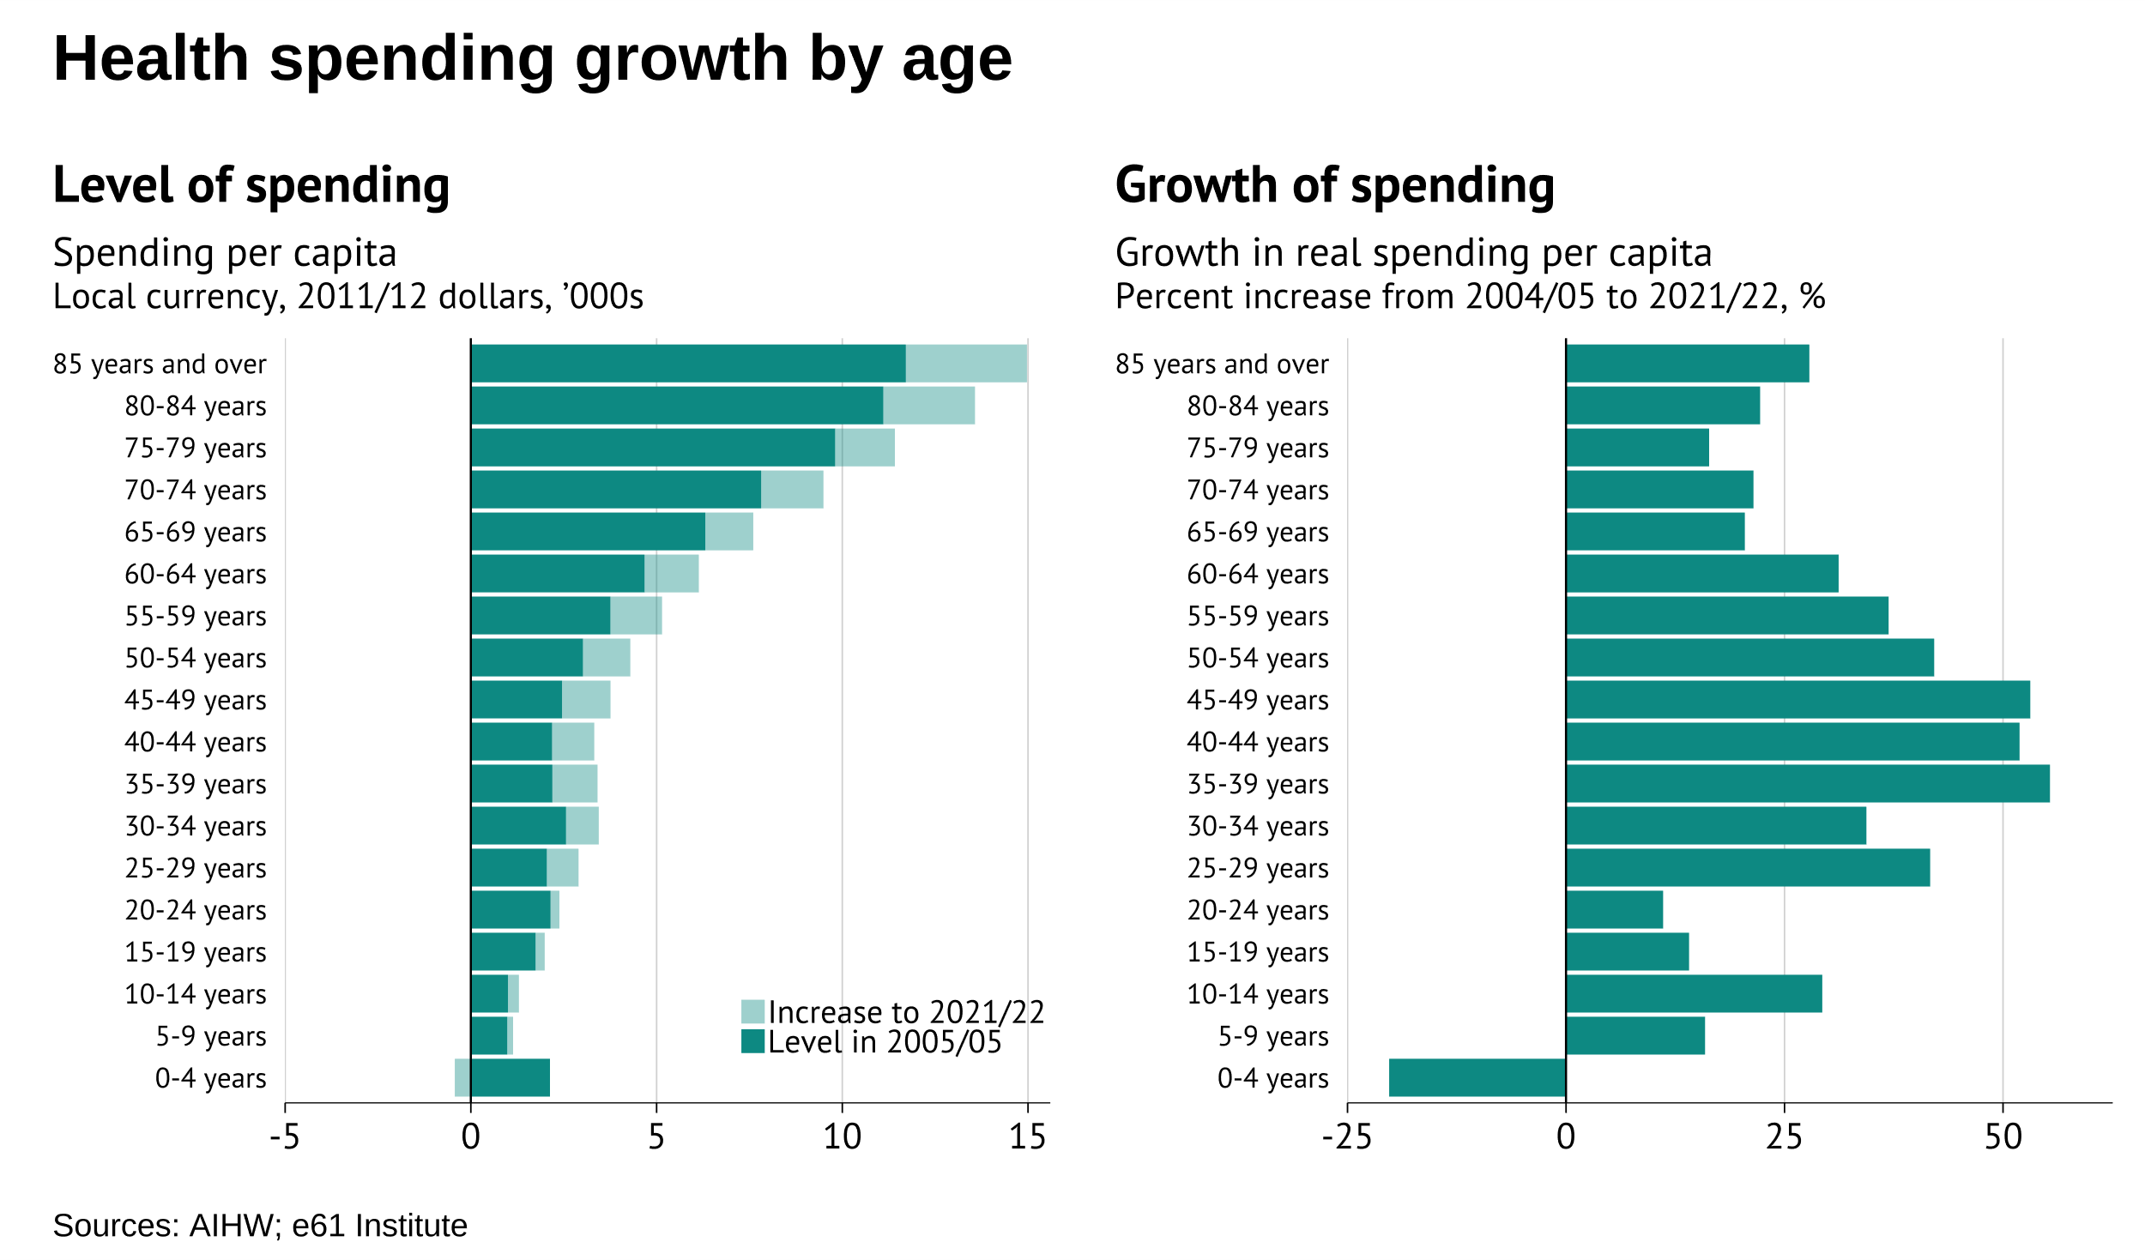
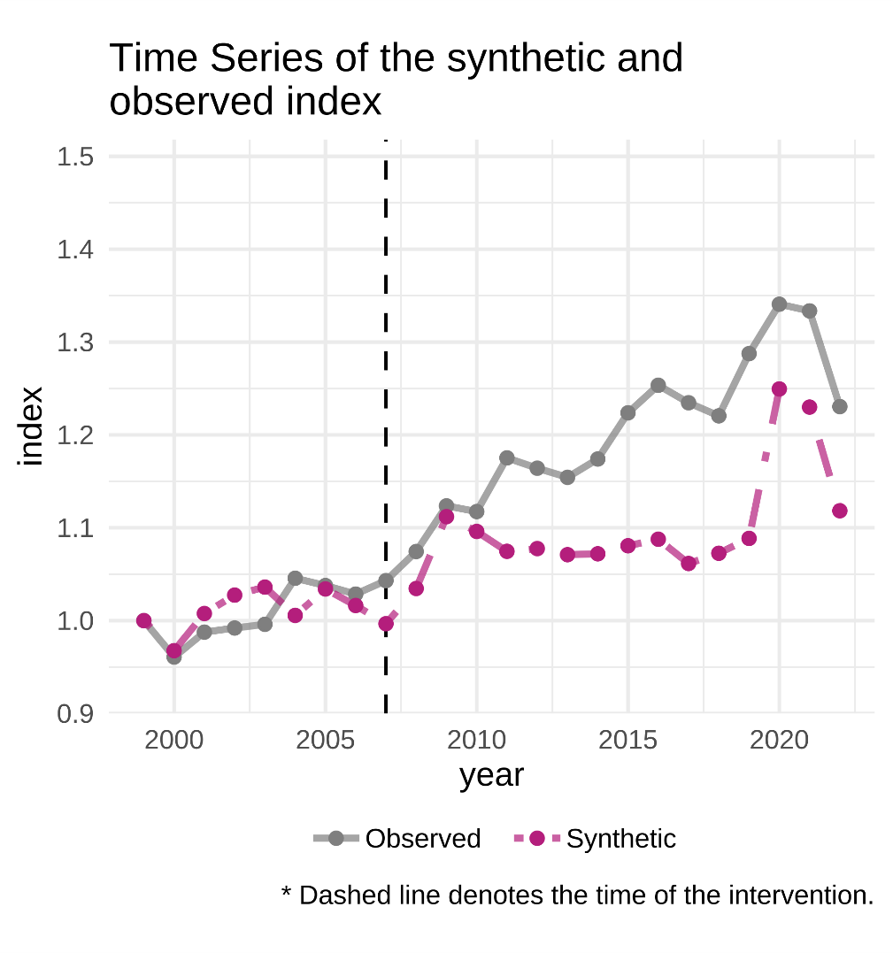
Age pressures of health spending
Back
GDP share compared to
similar countries

Slide 12
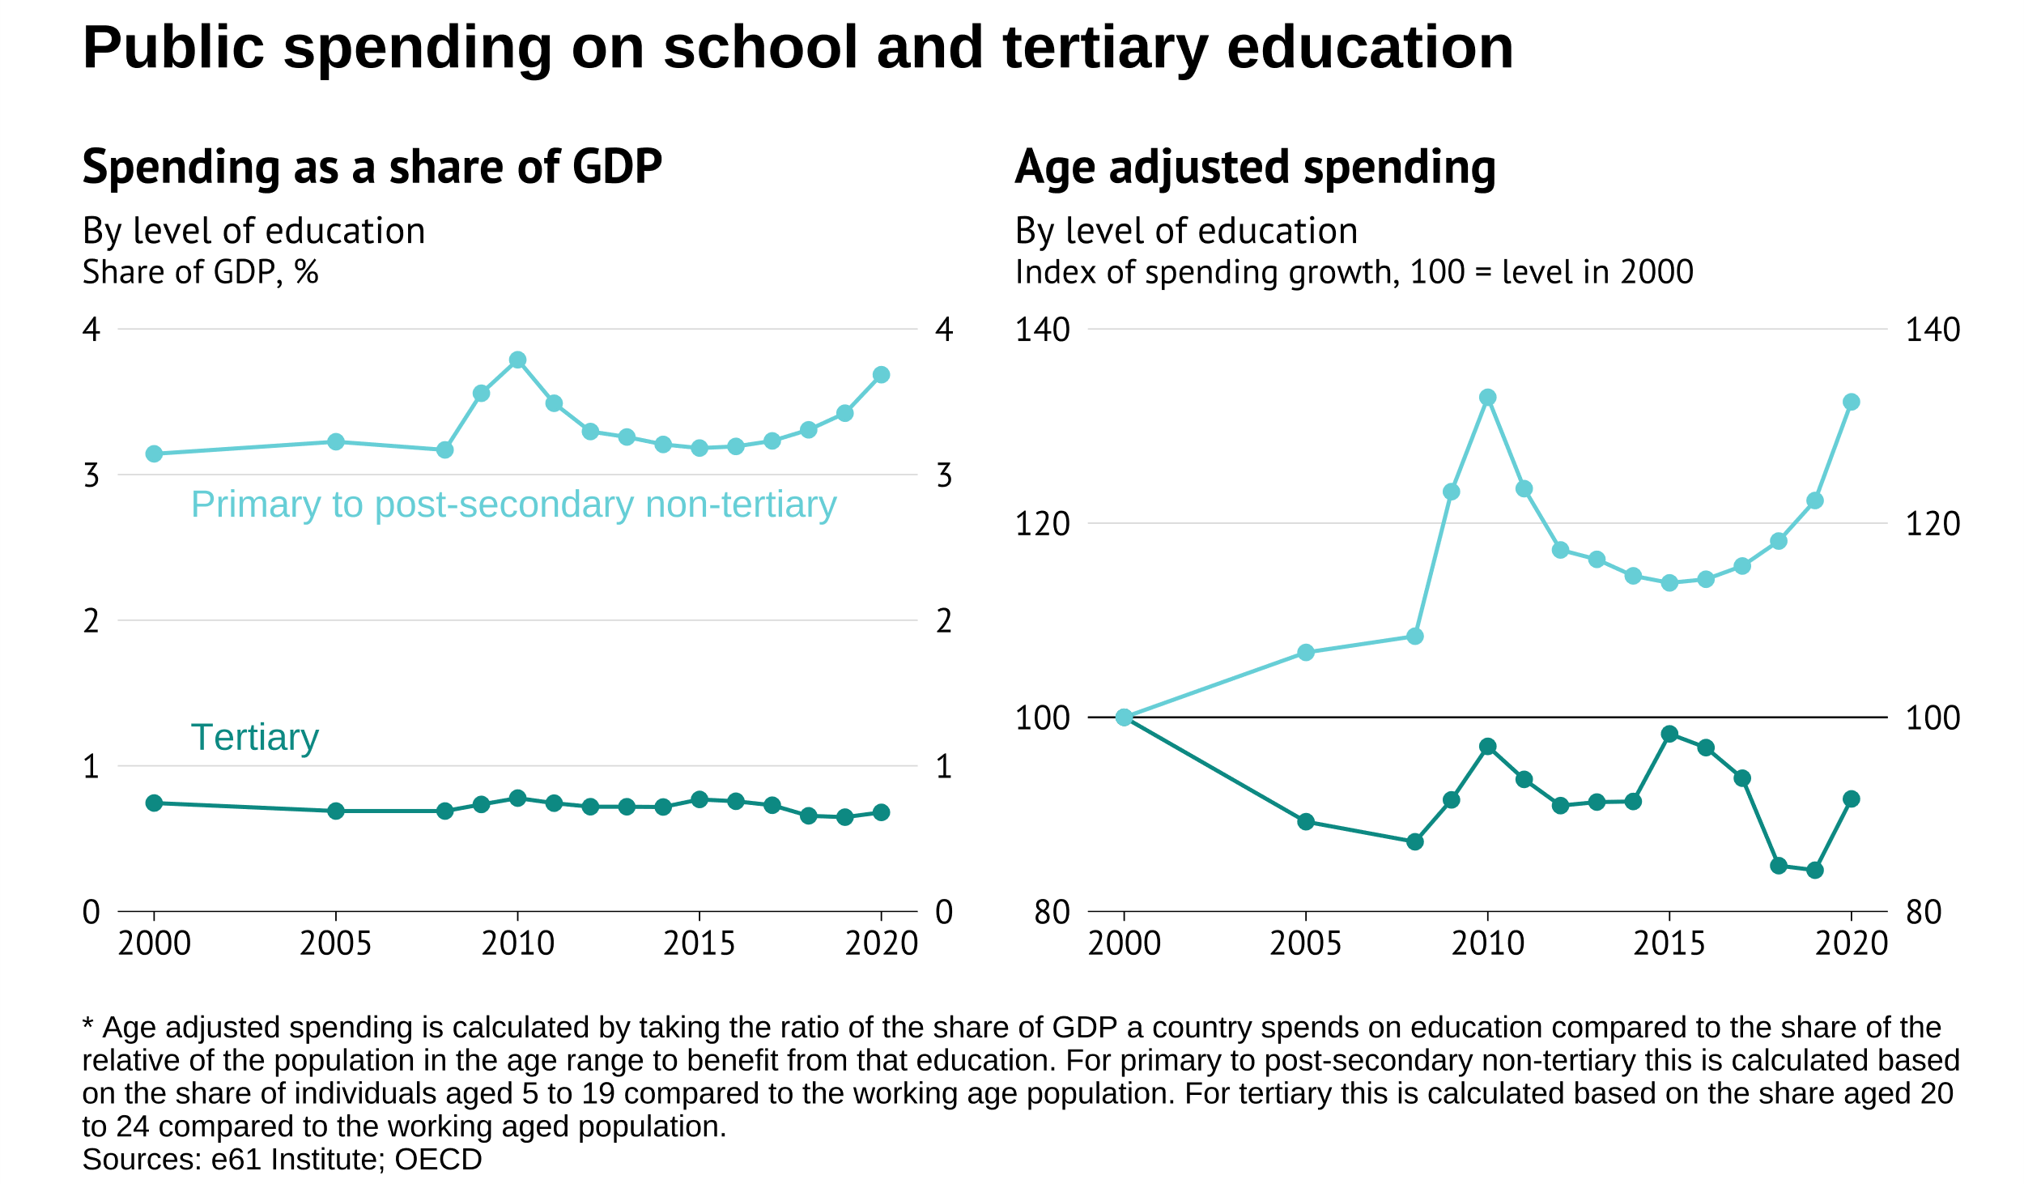
Age pressures of education spending
Note: Age adjustment still a
work in progress
Back

Slide 13
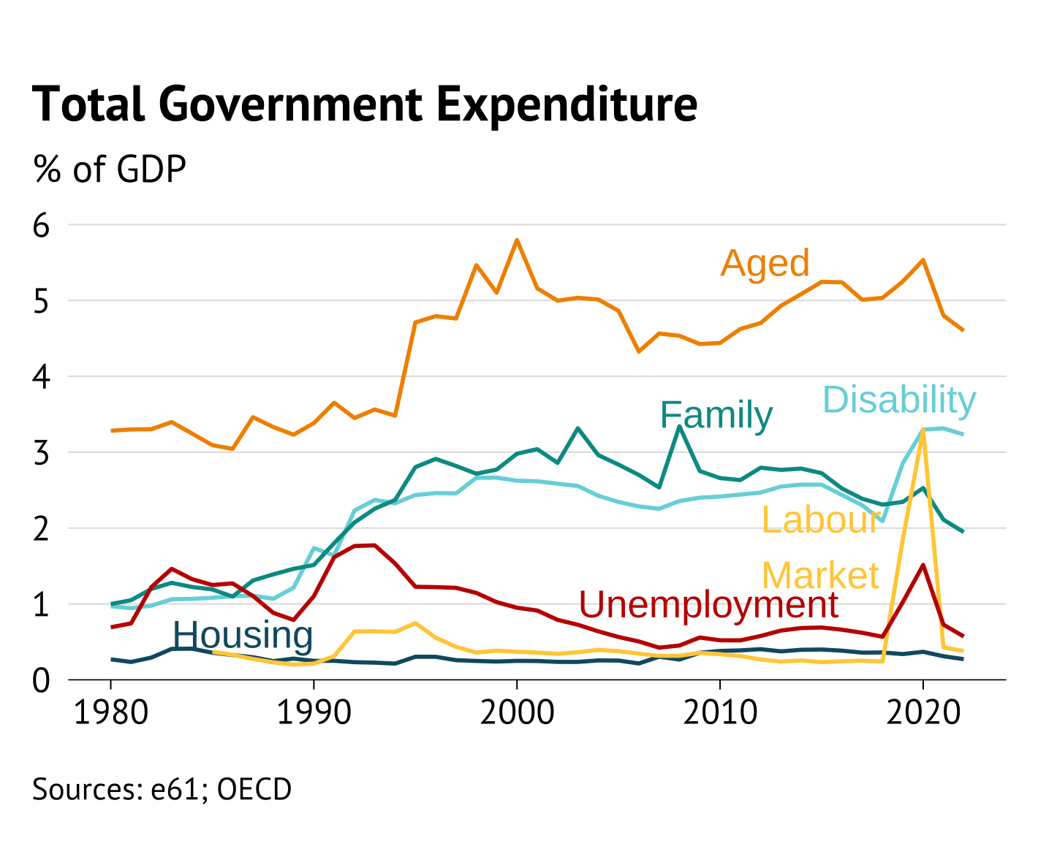
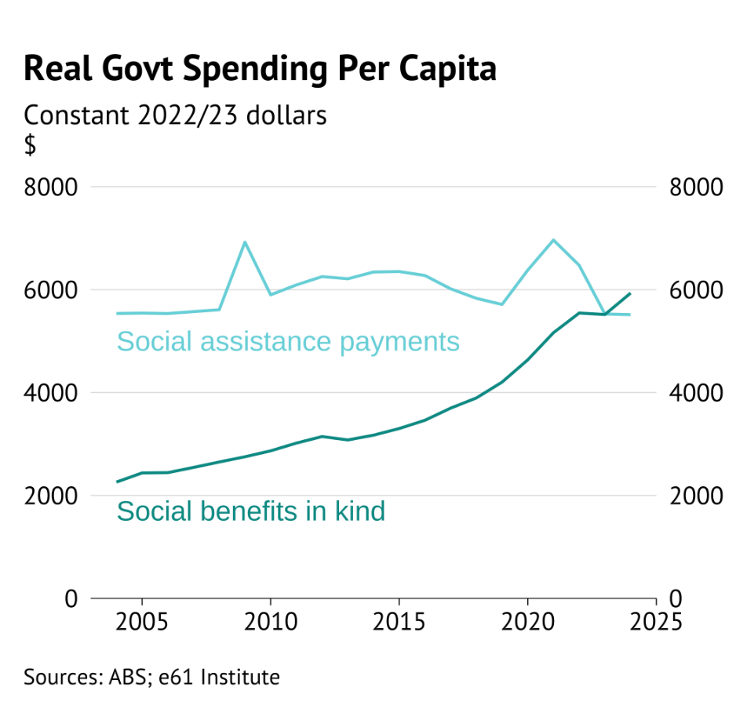
Transfers – cash vs in-kind
Back

Slide 14
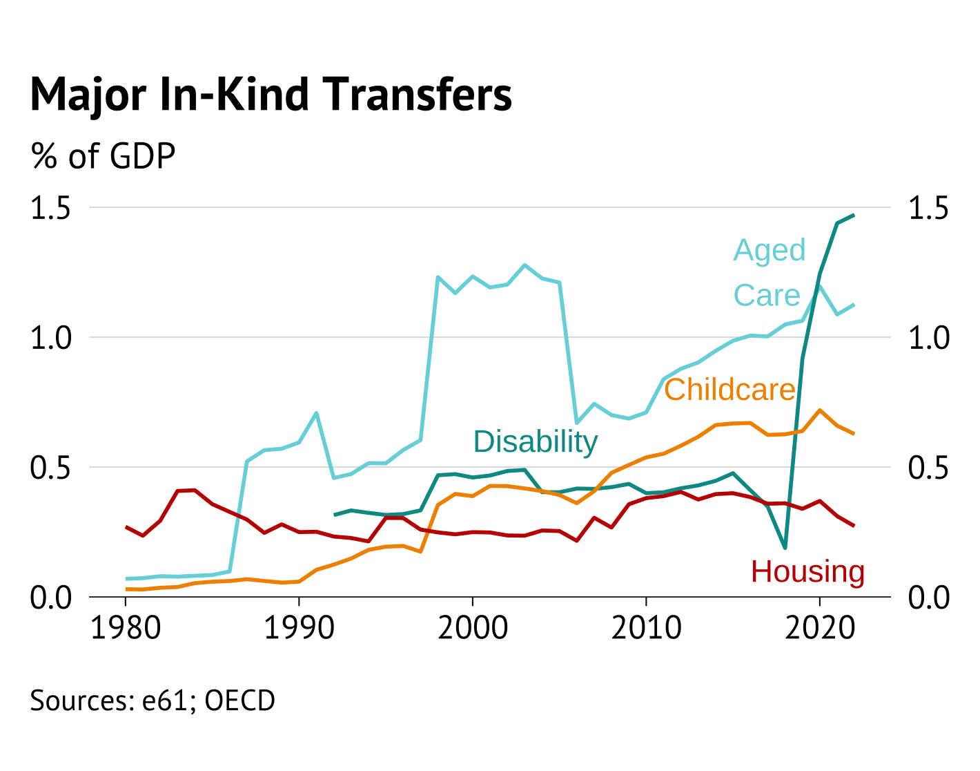
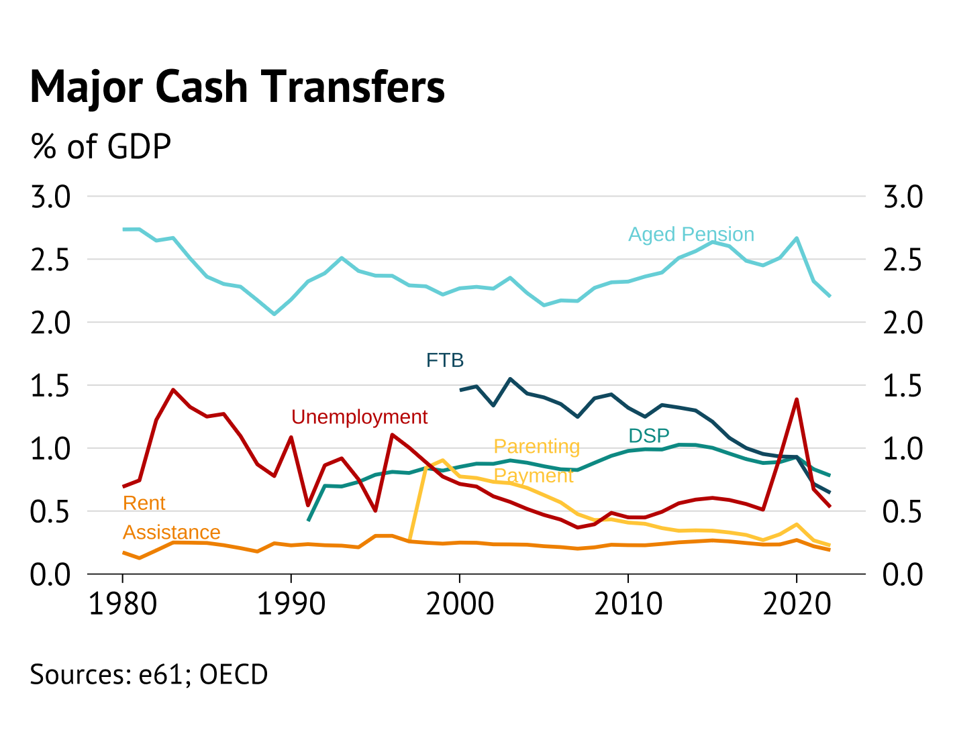
Transfer composition

Slide 15
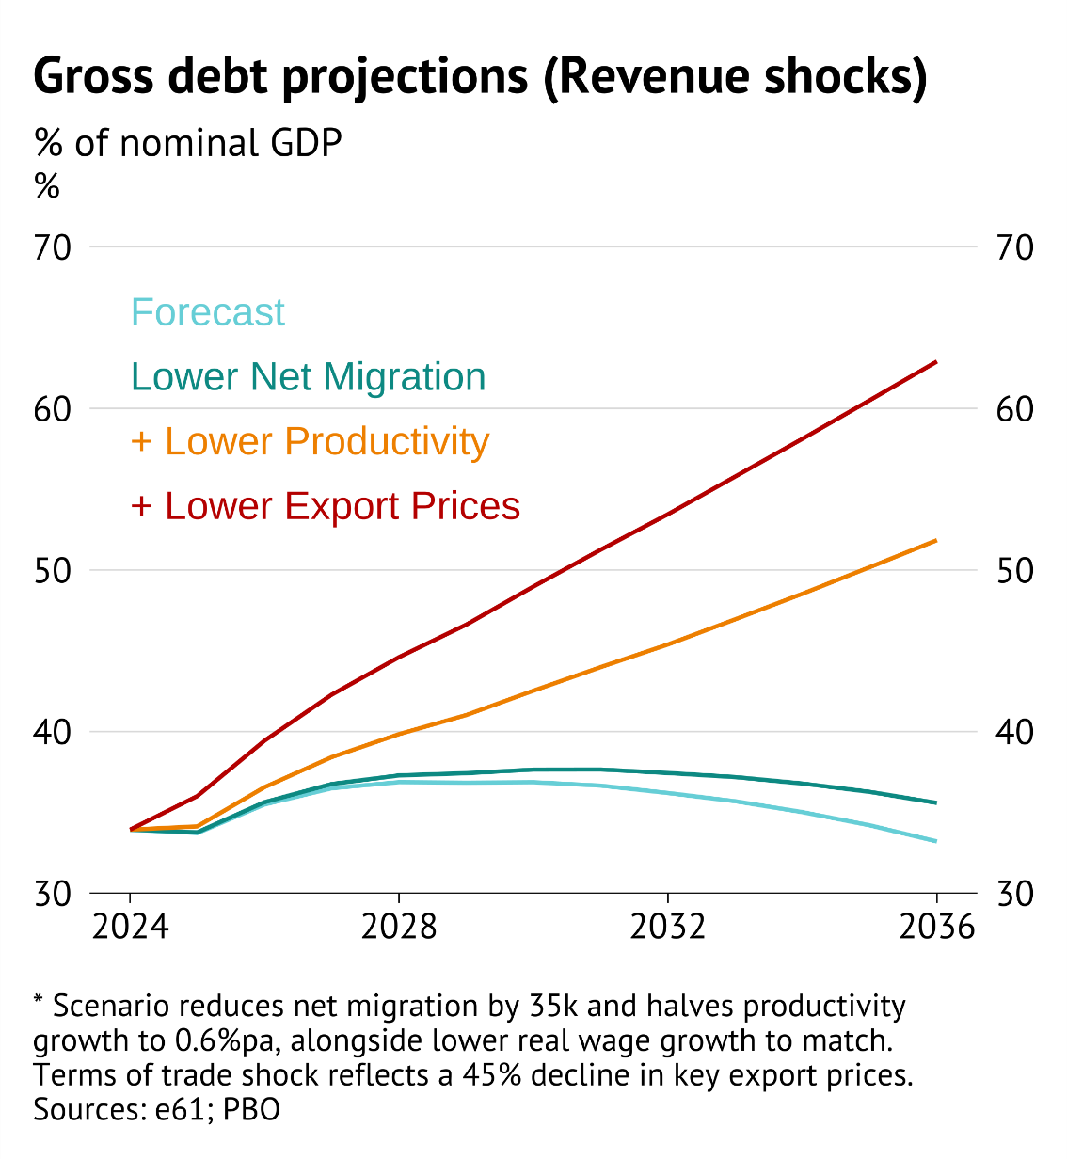
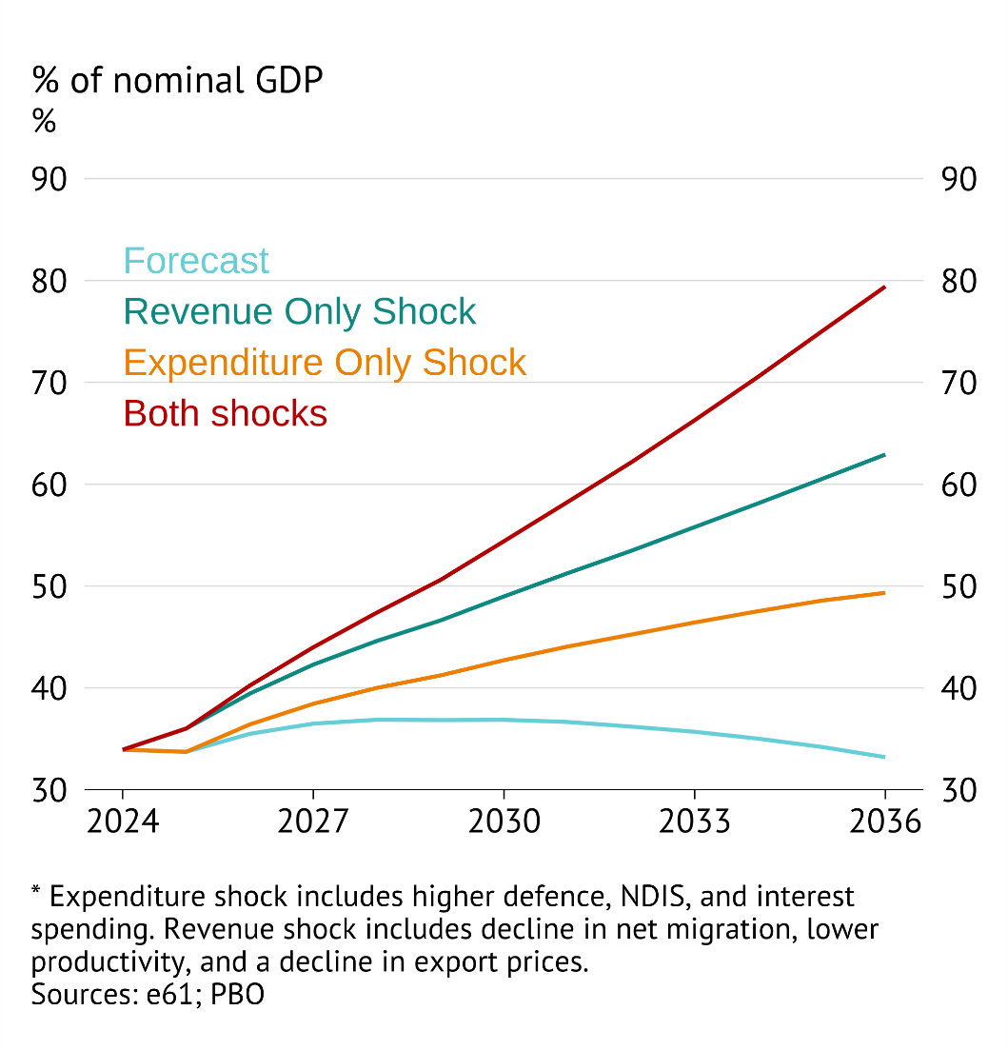
Gross debt scenarios
All shocks
Back

Slide 16
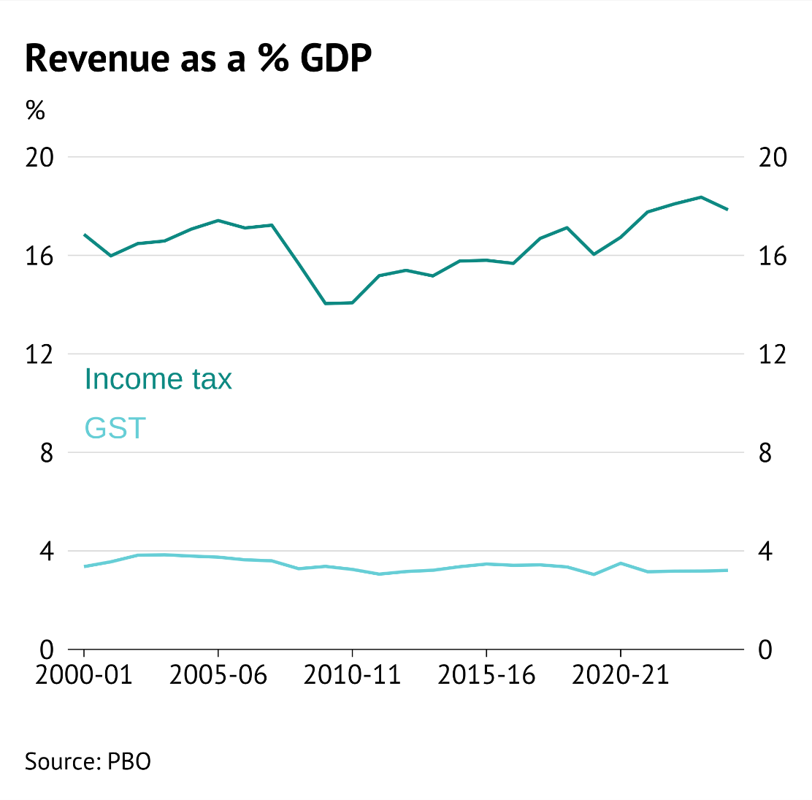
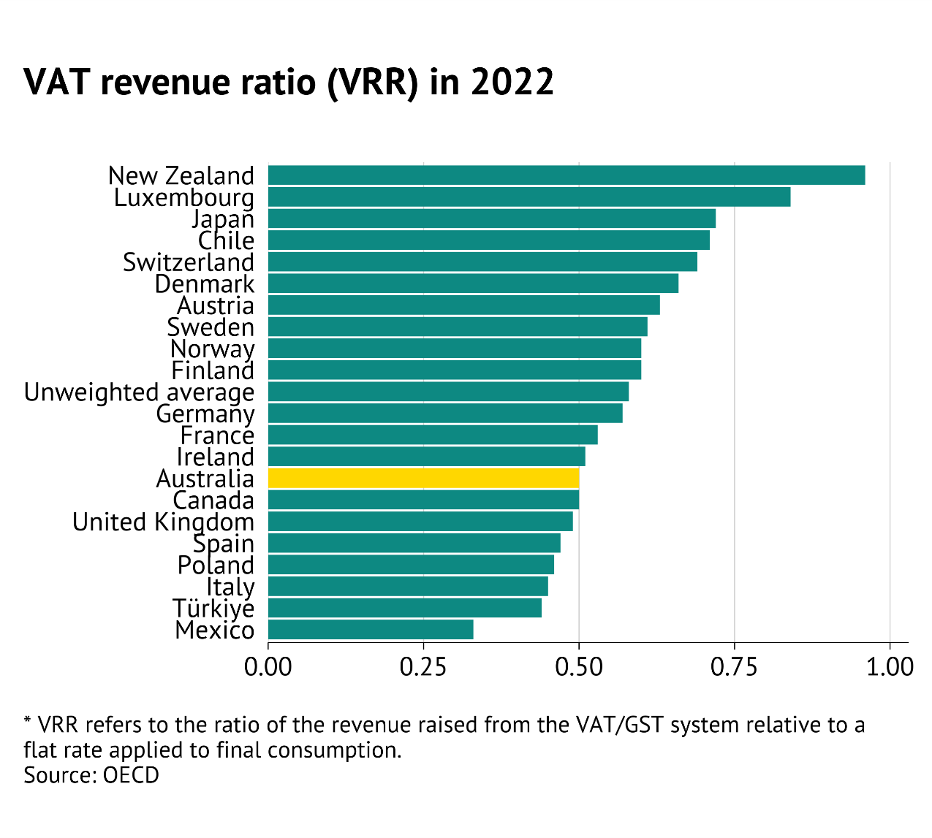
Revenue (personal)
Personal bases fairly constant
Consumption base not broad

Slide 17
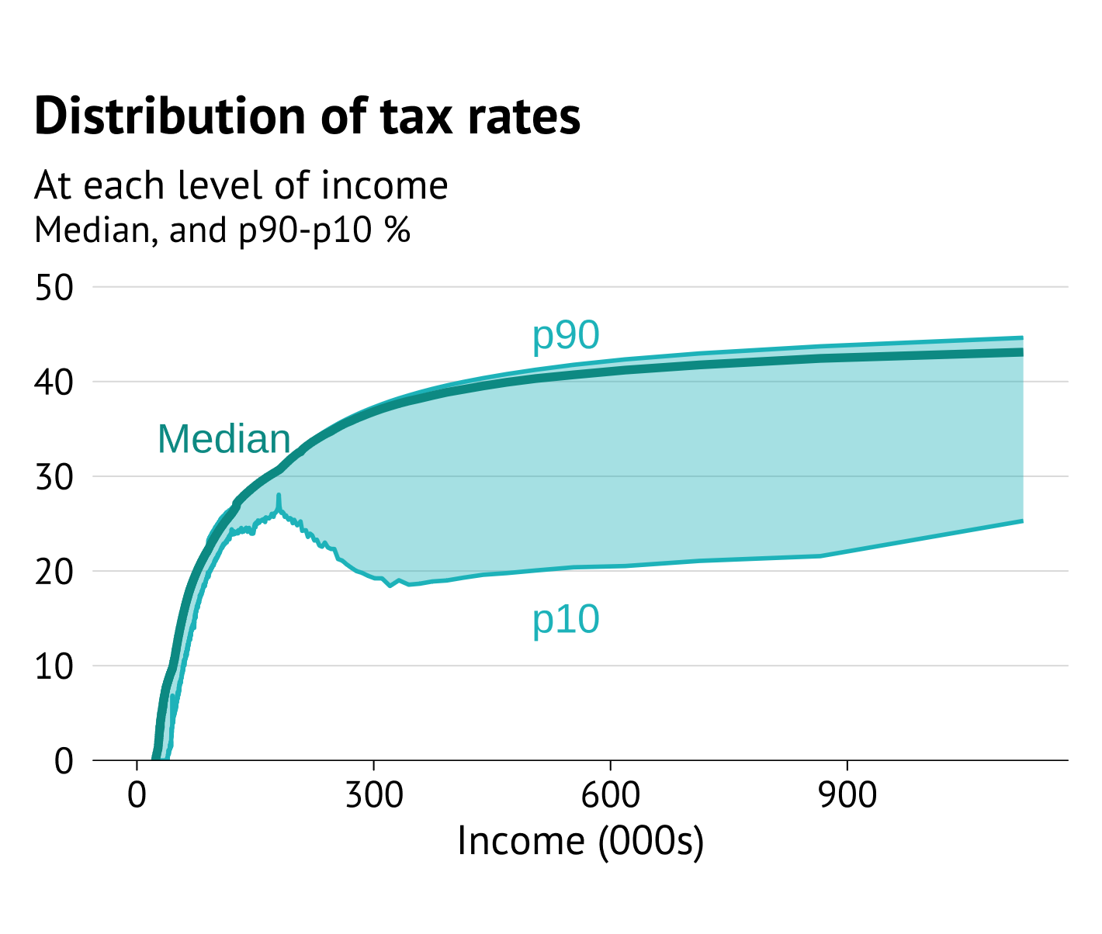
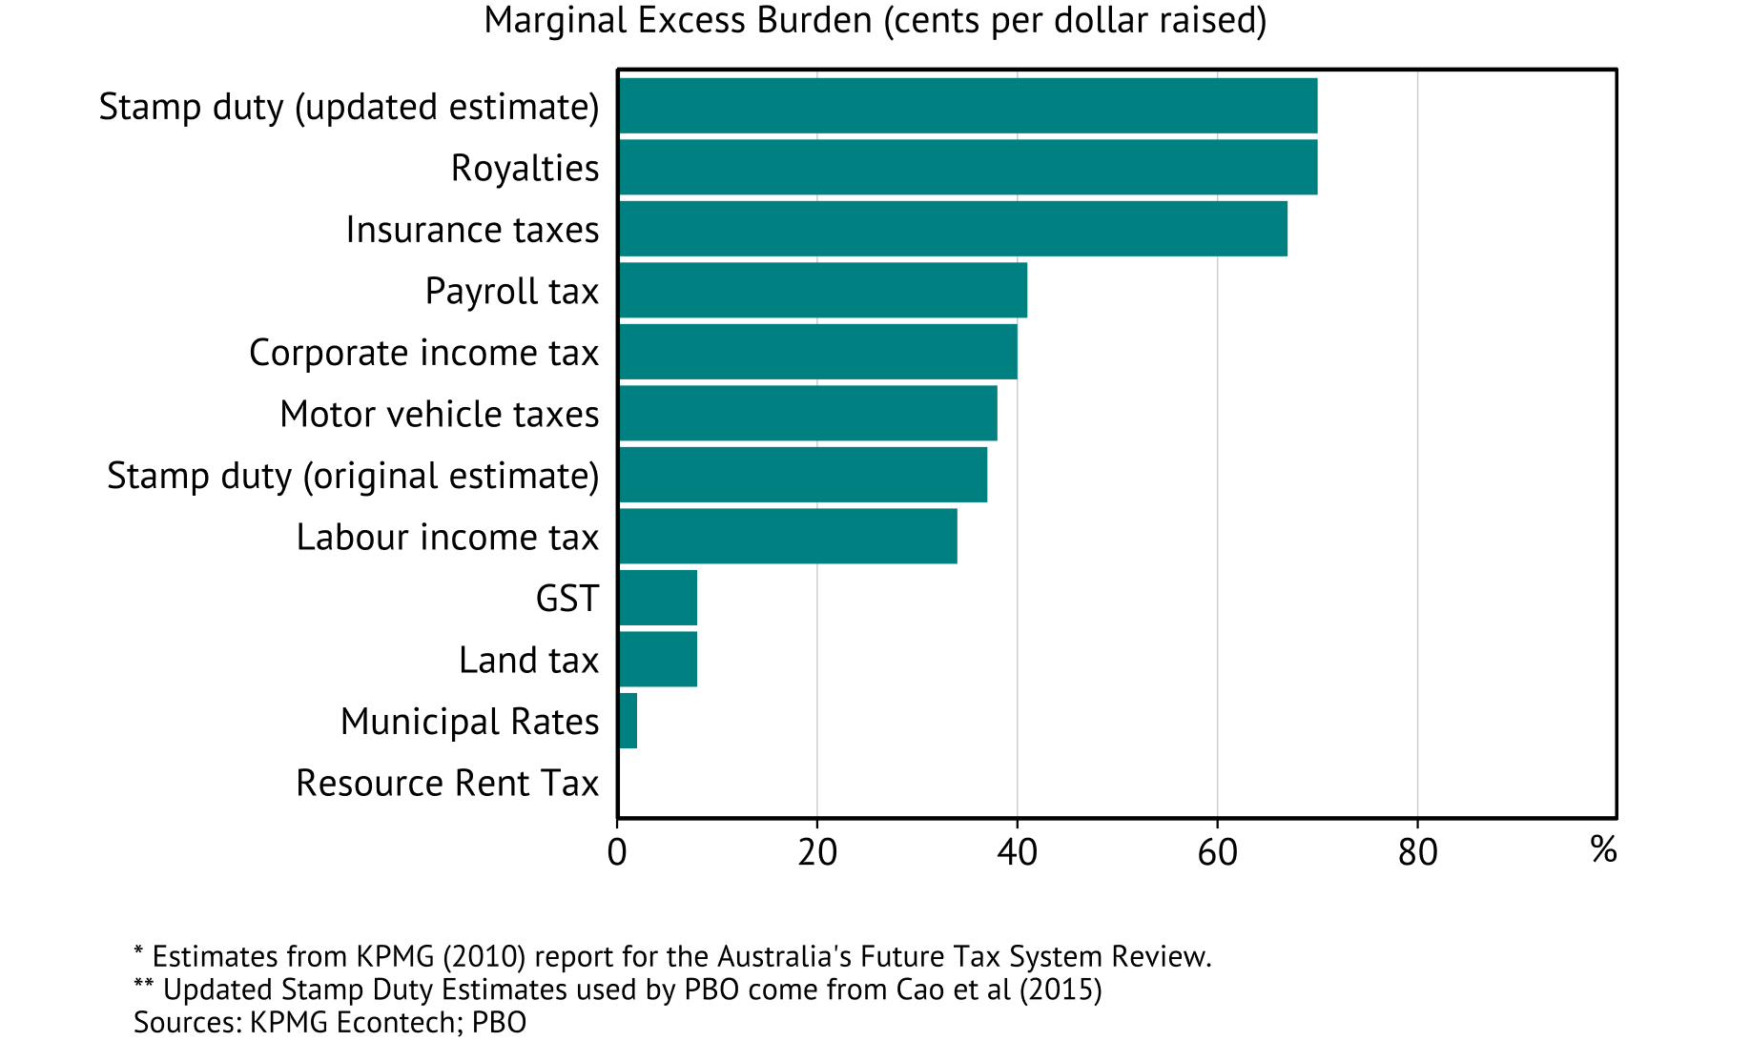
Revenue (personal)
Income base gaps
Inefficient taxes

Slide 18
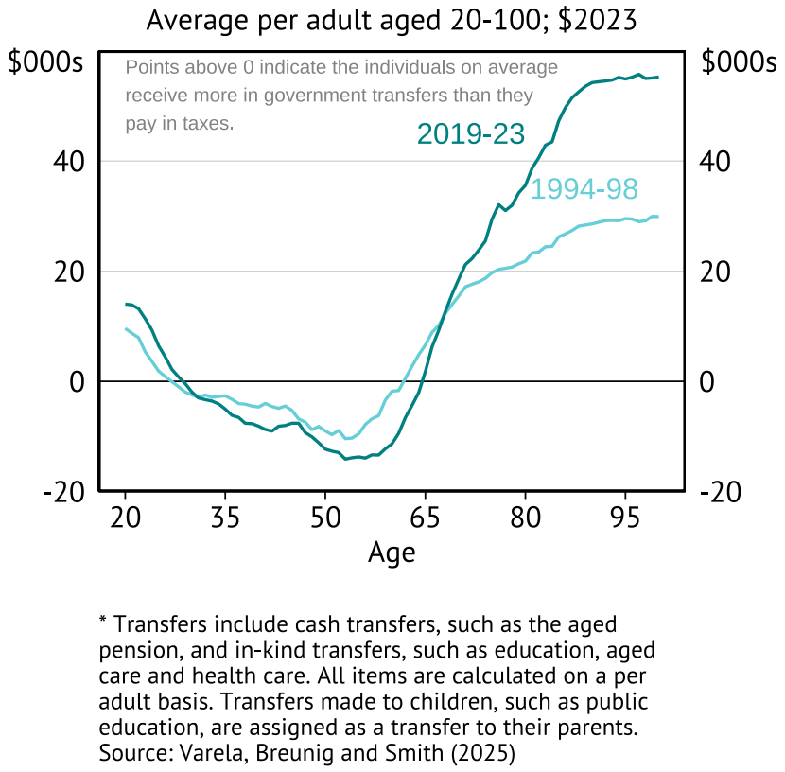
TTPI intergenerational transfer estimates
Estimated net fiscal transfer by age
Back

